Slide 1


Slide 2
Why ARMOR?
Meet your SOP's
Planned Maintenance
Effortlessly track and verify cleaning tasks for restrooms and floors to maintain pristine facilities.
Optimize operations by tracking and addressing charging and maintenance needs proactively.
Capital Planning
Inventory Accuracy
Enhance asset distribution strategies for prolonged and effective usage.
Ensure asset visibility and inventory validation through ARMOR mobile for streamlined operations.

Slide 3

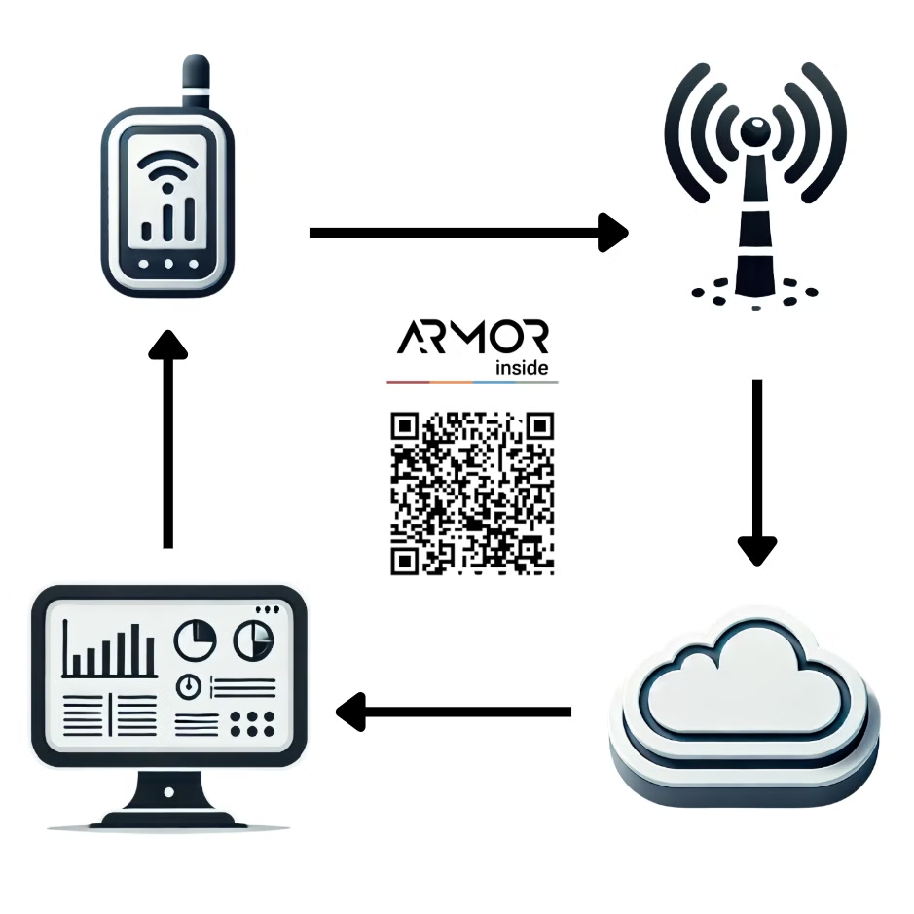



How It Works
Install ARMOR 4
Compact device easily installed on assets.
Connect & Transmit
Device connects via LTE cellular to send data.
Web Dashboard or Mobile App
Access insights, reports, and geofencing through intuitive user interfaces.

Slide 4
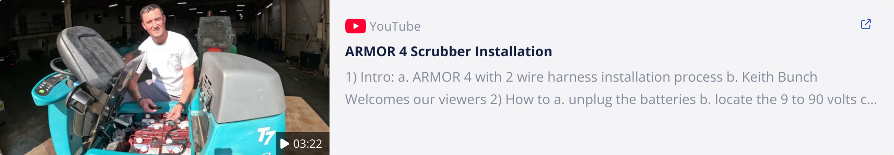
ARMOR 4 Installation Video Sample

Slide 5
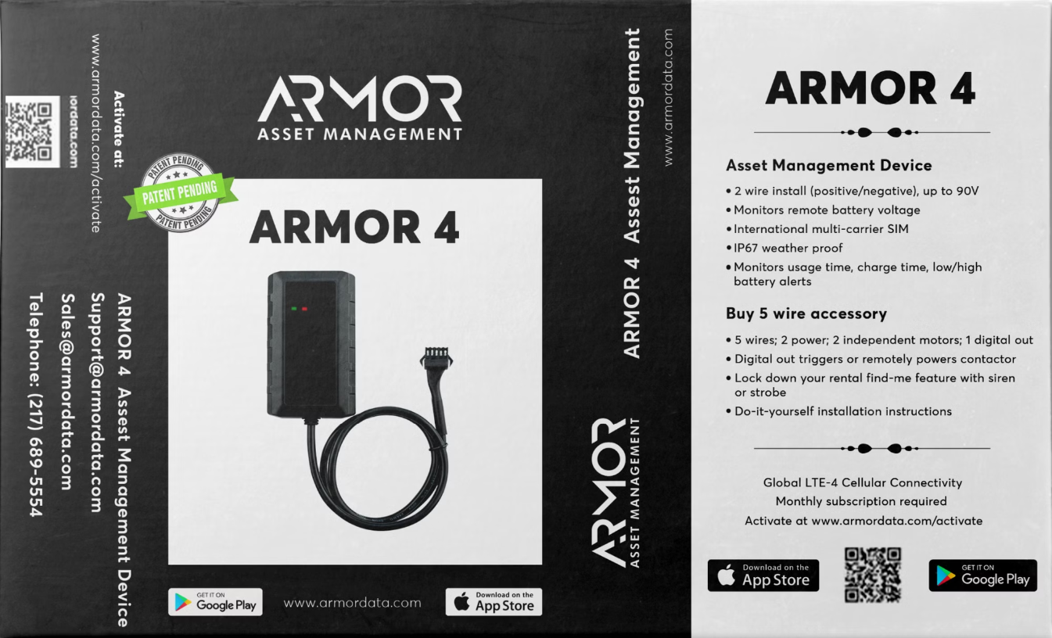
ARMOR 4 Hardware

Slide 6
Features
Advantages
2 wire install (positive/negative) up to 90v
100% cellular
Shows remote voltage
Azure Secure Cloud
International multi-carrier SIM
Bring Your Own Device (BYOD)
IP67 weatherproof
Action Based Reporting
190mA backup battery
Mobile Friendly
Tracks GPS location
Benefits
Tracks impact
Tracks usage metrics
Scalable
Alerts battery voltage issues
Vendor Agnostic
Powers between 9v and 90v
Easy Integration
Tamper alert if removed from the main power source
Turn Key OEM Installation
Priced Right

Slide 7
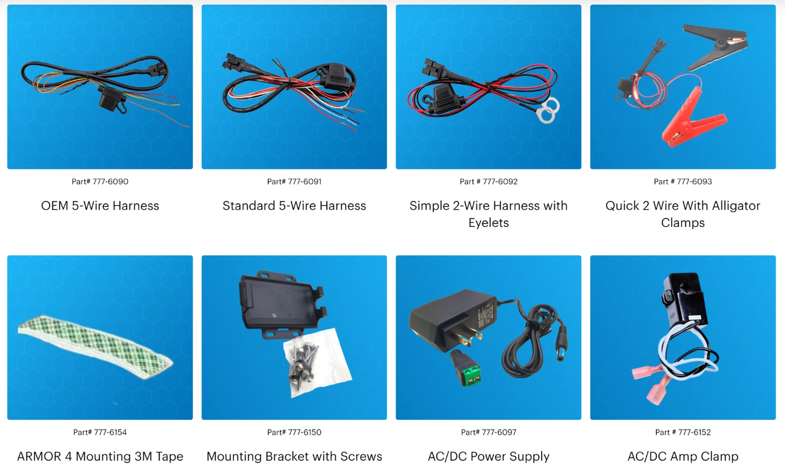
ARMOR 4 Accessories

Slide 8

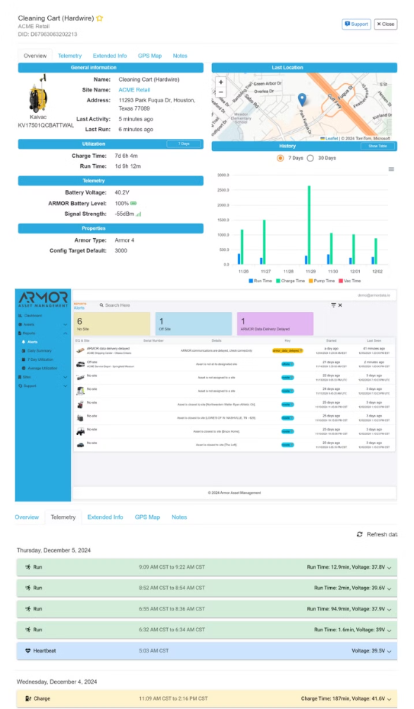




Platform Features & Benefits
Utilization & Location Tracking
Operational Insights
Monitor run time, idle time, distance, and battery health.
GPS and geofencing for constant asset location awareness and theft prevention.
Proactive Alerts & Reporting
Integration Ready
Seamlessly integrates with existing systems to streamline workflows with powerful APIs and OData feeds.
Receive alert notifications for asset issues or scheduled reports for fleet health.

Slide 9
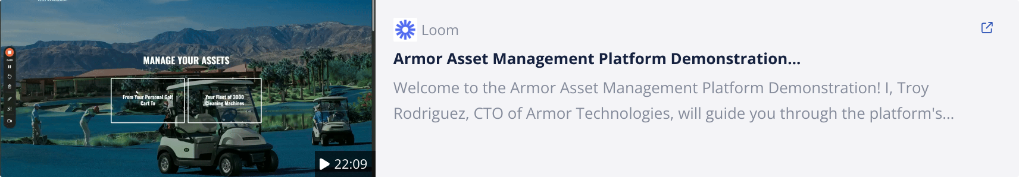
ARMOR Web App Walkthrough

Slide 10

ARMOR Mobile App Walkthrough

Slide 11

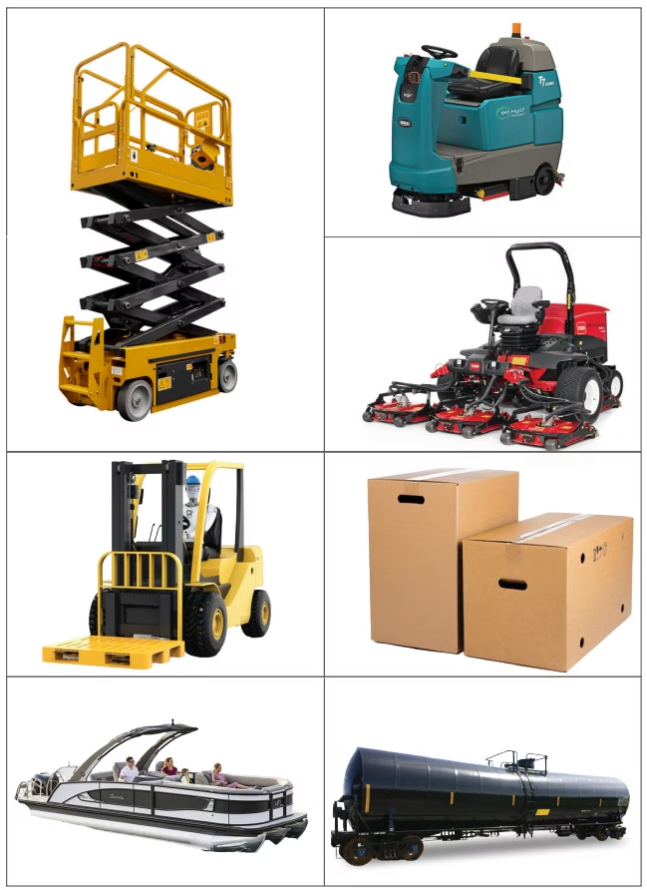
Sample Industry Applications
Floorcare
Transport
Monitor run time, charge time, and battery health of cleaning equipment.
Track run time, idle time, and distance traveled for fleet management.
Turf & Powerlifting
Adaptable
Monitor run time, charge time, routes, and battery health of equipment.
Highly flexible solutions that can be customized for various industries and numerous asset use cases.

Slide 12

Core Benefits of ARMOR
Solves Pain Points
Competitive Advantages
Addresses inefficient tracking, inventory discrepancies, unexpected downtime, and lack of actionable data.
Vendor agnostic, easy manufacturer or field deployment, proactive alerts, and highly scalable solution.
ROI
Reduces downtime, extends battery lifespan, and cuts operational costs, and improves asset lifecycle.

Slide 13

Next Steps
1
2
3
Review Resources
Define Use Cases
Reach Out
Review additional materials on the ARMOR website and Support Knowledgebase.
What key capital assets are most important to track?
Contact support for any technical questions, integrations, or assistance needed.
https://support.armordata.io
Get on a call with our Sales team and let them provide valuable feedback.
(217) 689-5554
https://armordata.com
support@armordata.com
sales@armordata.com
(217) 689-5554

